Slide 1
WELCOME TO Marble Falls
High School!

Slide 2
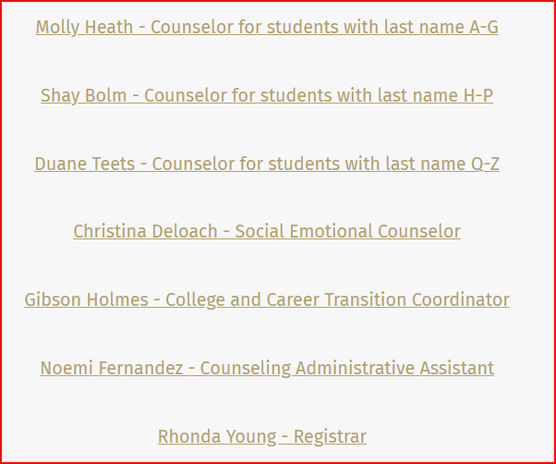
Meet our Counseling Staff!

Slide 3
Counseling website:
https://www.marblefallsisd.org/Page/698
  Google Marble Falls High School Counseling and it will come up!
Our website has lots of information:
  Scheduling , needed forms, Dual Credit info, presentations, scholarship info, senior information, summer information, testing, suicide or self-harm/community resources, club and organizations, etc.

Slide 4
Grades Matter
Attendance Matters

Slide 5
Grades/Attendance
You must make a 70 or higher to pass a course
You must not miss more than 10 days per semester in order to receive credit
Semester grades within the same school year can long average
  English 1A = 65 English 1B = 75 English 1 – 70 average for the year = 1 credit
  English 1A = 65 English 1B = 72 English 1 – 68 must repeat semester A of course
(Will get .5 credit for Sem. B)

Slide 6
Grade Classification in High School
        0 – 5.5 credits = 9th grade
6 – 12.5 credits = 10th grade
13 – 19.5 credits = 11th grade
20+ credits = 12th grade

Slide 7
What is GPA?
Grade Point Average - #1 thing colleges look at!
Included in GPA are core classes, foreign language and any Honors, Dual Credit (available to all students), On-Ramps or AP course taken on campus. Summer school and correspondence courses do not count.
  Core classes are English, Math, Science, and Social Studies
GPA starts with the first high school credit course taken on our campus (middle school grades do not count in GPA)!

Slide 8
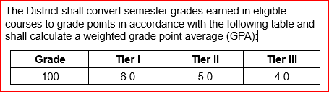
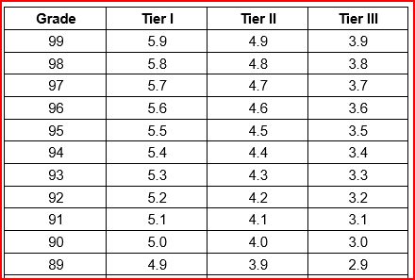
On-Level/DC/Honors/AP/On-Ramps
Tier I—All AP courses, all OnRamps courses, and eligible dual credit courses (2 points added to on-level GPA)
Tier II—Eligible courses locally designated as Honors (1 point added to on-level GPA)
Tier III—All other eligible courses. On-level GPA.

Slide 9
What is Class Rank?
Based on your weighted GPA
Only includes the courses that count in GPA
Top 10% can get automatic admission to Texas public colleges (see automatic admissions chart). You can apply to colleges at the end of your Junior year, so you have 6 semesters to impress colleges!
Your rank is determined by your GPA and the total number of students in your class:
    Divide your class rank by the total number of students in your class to get your percentile rank. Hint – your class size will likely get smaller each year.

Slide 10
GPA and Rank
GPA and rank are sent to apply for colleges at the end of the Junior year.
Rank at the end of the Junior year or Senior year can be used to determine admission to colleges, including automatic admission for Texas colleges.

Slide 11
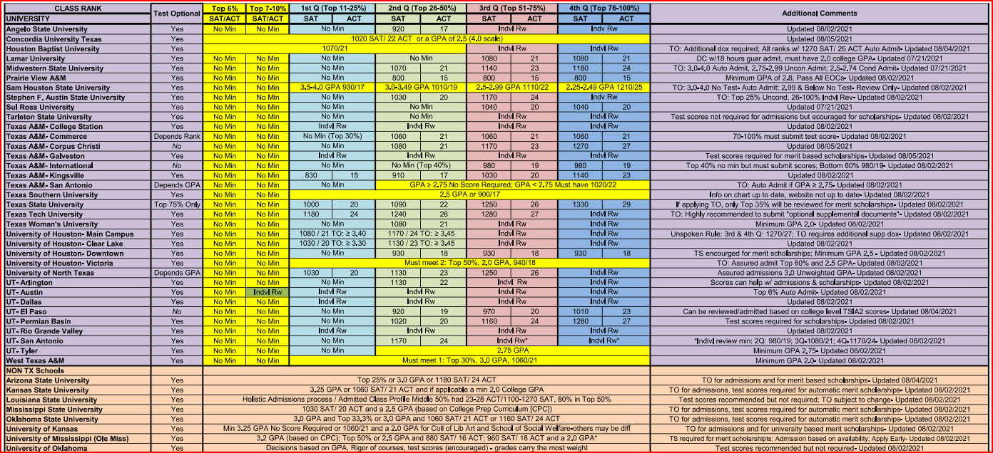
Assured Admission (Guaranteed to get in)!

Slide 12
Automatic Admission Requirements for Texas Public Universities (could change)
UT Austin
-Must be in top 6% of graduating class
Sul Ross State University
-Students in the top 50% receive assured admission
Texas A&M
-Top 10%: No test score requirements.
-Top 25%: Individual review
UT Permian Basin
-Must be in top 25% of graduating class.
26-50% - SAT 1020 or ACT 20
Texas Tech
-Top 10%: No test score requirements.
-Top 25%: SAT 1180; ACT 24
Angelo State University
-Top 25%: No test score requirements.
-Top 50%: SAT 920; ACT 17
Texas State University
-Top 10%: No test score requirements.
-Top 25%: SAT 1000; ACT 20

Slide 13
The Distinguished Level of Achievement
The Distinguished Level of Achievement will:
Allows students to be considered for Top 10% automatic admissions eligibility at any Texas public university with the exception of The University of Texas at Austin; Automatic admission standards for UT are established during the student’s junior year
What it means
The Distinguished Level of Achievement requires more math and more science than the Foundation High School Program.
The Distinguished Level of Achievement requires:
A total of four credits in math, including Algebra II;
A total of four credits in science; and
Successful completion of an endorsement in your area of interest.

Slide 14
Subject Area | Number of Required Credits
English | 4: English 1, 2, 3, 4
Math | 4: Algebra 1 & Geometry plus 2 additional math credits
Science | 4: Biology, IPC, Chem or Physics, plus 2 additional science credits
Social Studies | 3 (4 recommended) World Geo or WH, USH and Gov/Eco
LOTE | 2 levels in same foreign language
PE | 1 credit in PE or PE equivalent
Fine Arts | 1: Art, Dance, Band, Choir, Theater, Floral Design
Electives | 9 28 Total Credits Required for Graduation

Slide 15
What are the five endorsement areas (need one to graduate on the recommended or higher grad plan)?
    1. STEM
    2. Public Services
    3. Business and Industry
    4. Arts and Humanities
    5. Multidisciplinary Studies

Slide 16
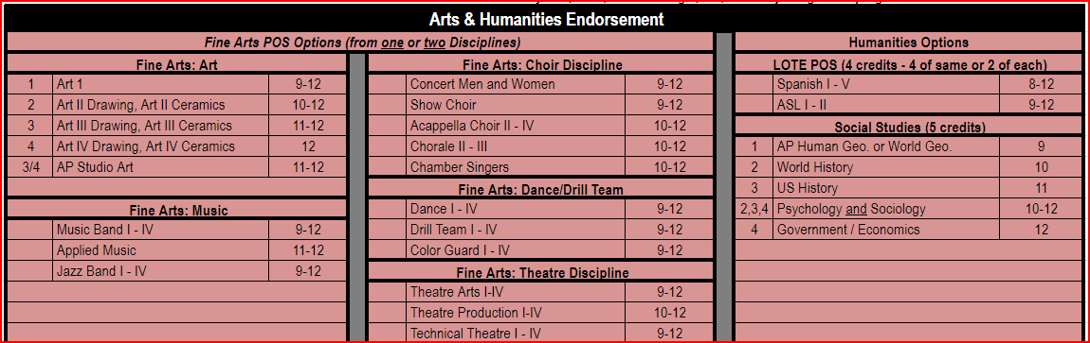
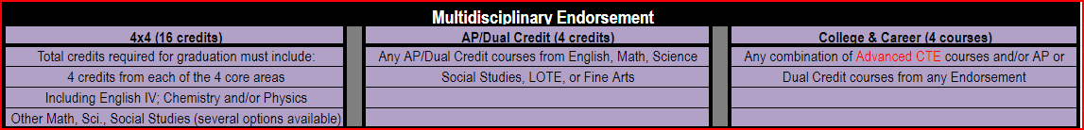

Slide 17
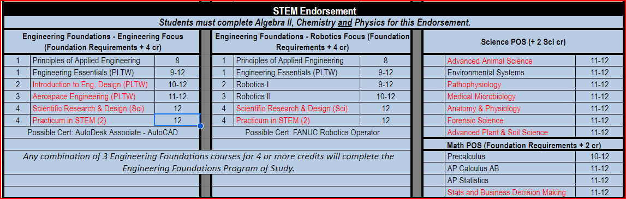
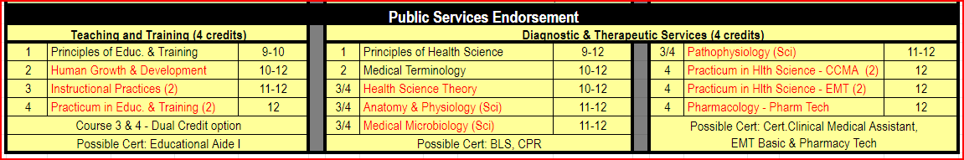

Slide 18
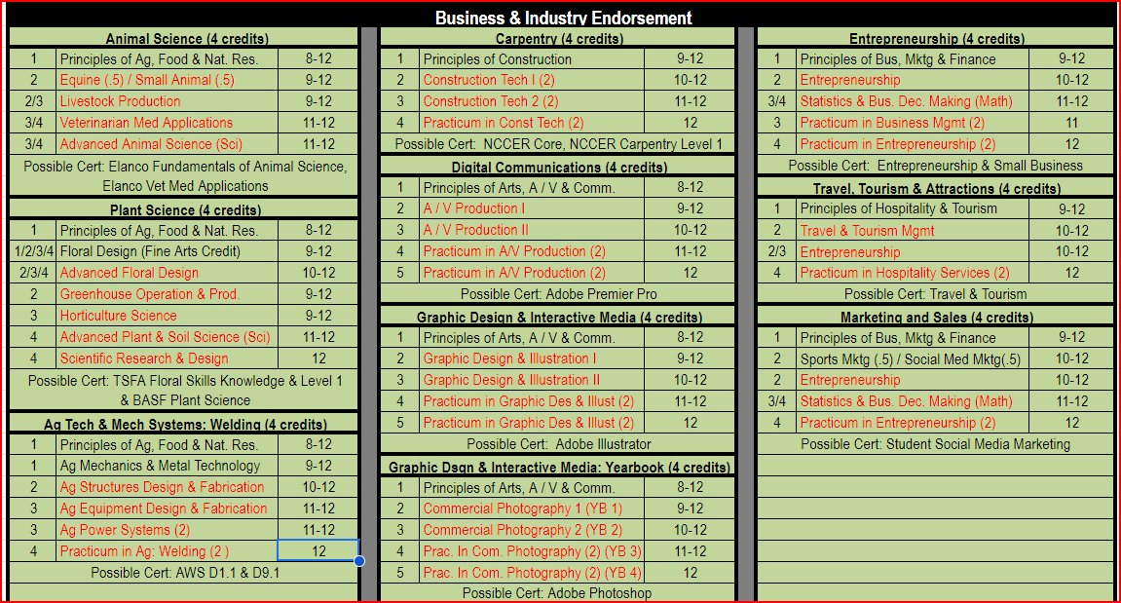

Slide 19
End of Course Exams (STAAR Tests)
English 1 (9th)
Algebra 1 (9th) – 8th graders currently in Algebra 1 will take in middle school
Biology (9th)
English II (10th)
US History (11th)

Slide 20

Early College High School
Free college hours for ALL students.
Flexible scheduling - as few as 6 college hours up to a 60 hour Associates of Arts degree.
If you think your student will take dual credit or OnRamps courses, sign up for ECHS for free college hours!
Stay involved in extracurriculars, clubs, and athletics!
Applications due on February 16th

Slide 21
Questions?

